Slide 1



Wave shop item
공격력증가
칼 : <a href="https://www.flaticon.com/free-icons/sword" title="sword icons">Sword icons created by Freepik - Flaticon</a>
파란 화살표 : <a href="https://www.flaticon.com/free-icons/up-arrow" title="up arrow icons">Up arrow icons created by Freepik - Flaticon</a>

Slide 2

Wave shop item
공격속도증가
파란 화살표 : <a href="https://www.flaticon.com/free-icons/up-arrow" title="up arrow icons">Up arrow icons created by Freepik - Flaticon</a>

Slide 3

Wave shop item
크리티컬 확률 증가
데미지 마크 : <a href="https://www.flaticon.com/free-icons/damage" title="damage icons">Damage icons created by Febrian Hidayat - Flaticon</a>

Slide 4
Wave shop item
크리티컬 데미지 증가
데미지 마크 : <a href="https://www.flaticon.com/free-icons/damage" title="damage icons">Damage icons created by Febrian Hidayat - Flaticon</a>

Slide 5
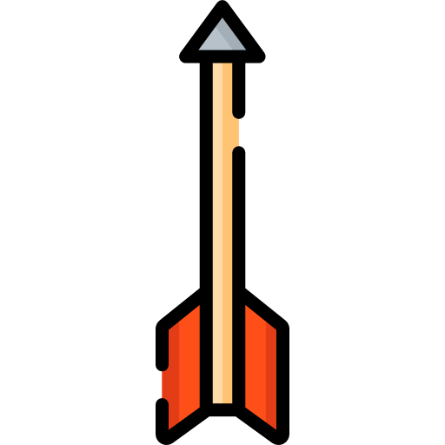
Wave shop item
공격 개수 증가
화살: <a href="https://www.flaticon.com/free-icons/bow" title="bow icons">Bow icons created by Freepik - Flaticon</a>

Slide 6

Wave shop item
사거리 증가
거리(resize) : <a href="https://www.flaticon.com/free-icons/edit-tools" title="edit tools icons">Edit tools icons created by Freepik - Flaticon</a>

Slide 7

Wave shop item
공격 방향 증가
파란 화살표 마크 : <a href="https://www.flaticon.com/free-icons/up-arrow" title="up arrow icons">Up arrow icons created by Freepik - Flaticon</a>

Slide 8

Wave shop item
이동속도증가
신발 : <a href="https://www.flaticon.com/free-icons/sprint" title="Sprint icons">Sprint icons created by Flat Icons - Flaticon</a>

Slide 9

Wave shop item
체력 증가
하트 : <a href="https://www.flaticon.com/free-icons/hearts" title="hearts icons">Hearts icons created by smalllikeart - Flaticon</a>

Slide 10




Wave shop item
당근 자물쇠
당근 : <a href="https://www.flaticon.com/free-icons/carrot" title="carrot icons">Carrot icons created by Whitevector - Flaticon</a>
왕관 : <a href="https://www.flaticon.com/free-icons/bling" title="bling icons">Bling icons created by Freepik - Flaticon</a>
자물쇠 : <a href="https://www.flaticon.com/free-icons/lock" title="lock icons">Lock icons created by Freepik - Flaticon</a>
목걸이 : <a href="https://www.flaticon.com/free-icons/rapper" title="rapper icons">Rapper icons created by juicy_fish - Flaticon</a>

